Slide 1

UPI (Unified Payment Interface)
Mayank Ingale 20bcs127
Meravath Pavan 20bcs129
Mihir Solanki 20bcs131
Er-diagram
pupose
working
end
perks
about
Tech-stack
Ta Name: Poornima Singh
16/11/2021

Slide 2
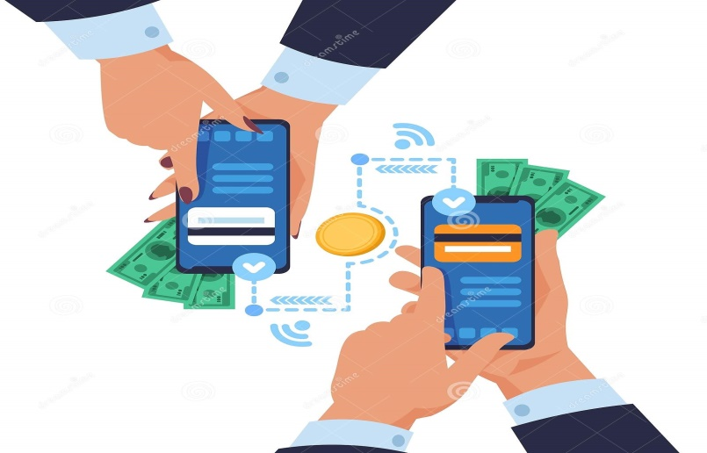
WHAT IS UPI ?
Er-diagram
purpose
end
perks
about
working
Tec-stack
Platform that merges several
bank servises
instantly transferring funds between two bank accounts on a mobile platform.

Slide 3



1
2
We cannot transfer money from wallet to bank account in some upi’s.
Er-diagram
Tech-stack
purpose
end
working
about
perks
Server down problem’s
3
We will try to overcome this issues

Slide 4




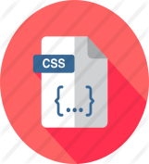



TECH STACK
end
purpose
working
Tec satck
perks
about
Er-diagram
CSS
HTML
JAVA SCRIPT
BOOT STRAP
NODE JS

Slide 5
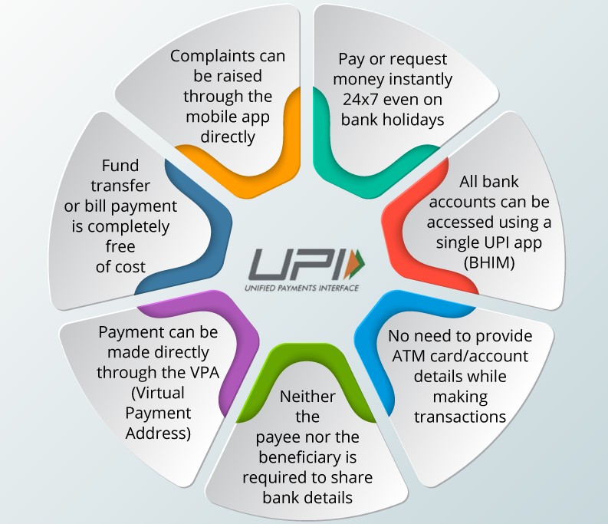


WHY UPI ?
Perks of upi !
02
03
Er-diagram
purpose
end
working
perks
Tec - stack
about

Slide 6




Bank-A
Bank-B
pupose
Tech-stack
working
end
perks
about
Er-diagram

Slide 7
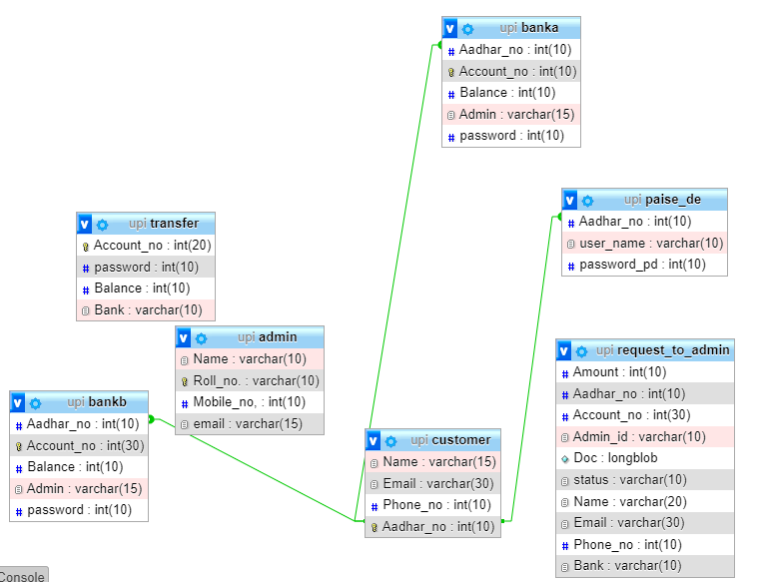
Er-diagram
end
Er-diagram
history
services
perks
end
timeline
about

Slide 8

Thankyou
Er-diagram
history
services
perks
end
timeline
about
end

